Slide 1
Journey Scrapbook
Akshat Gupta
Batch-6

Slide 2
Custom Training Week - 3
11-Sept-2023 to 15-Sept-2023

Slide 3
Day 1
Azure Data Factory Doubt session

Slide 4
Day 2
Creating Azure Synapse Analytics
Dedicated pool and Serverless pool
Implementing Partitions for an SQL Data Warehouse
Table partitions enable us to divide data into smaller groups of data
Table Partitions – Clustered Columnstore, Clustered Index, Heap
Apache Spark Pool – supports Python, Scala and Spark SQL
Serverless and Dedicated Pool
Data Exploration

Slide 5
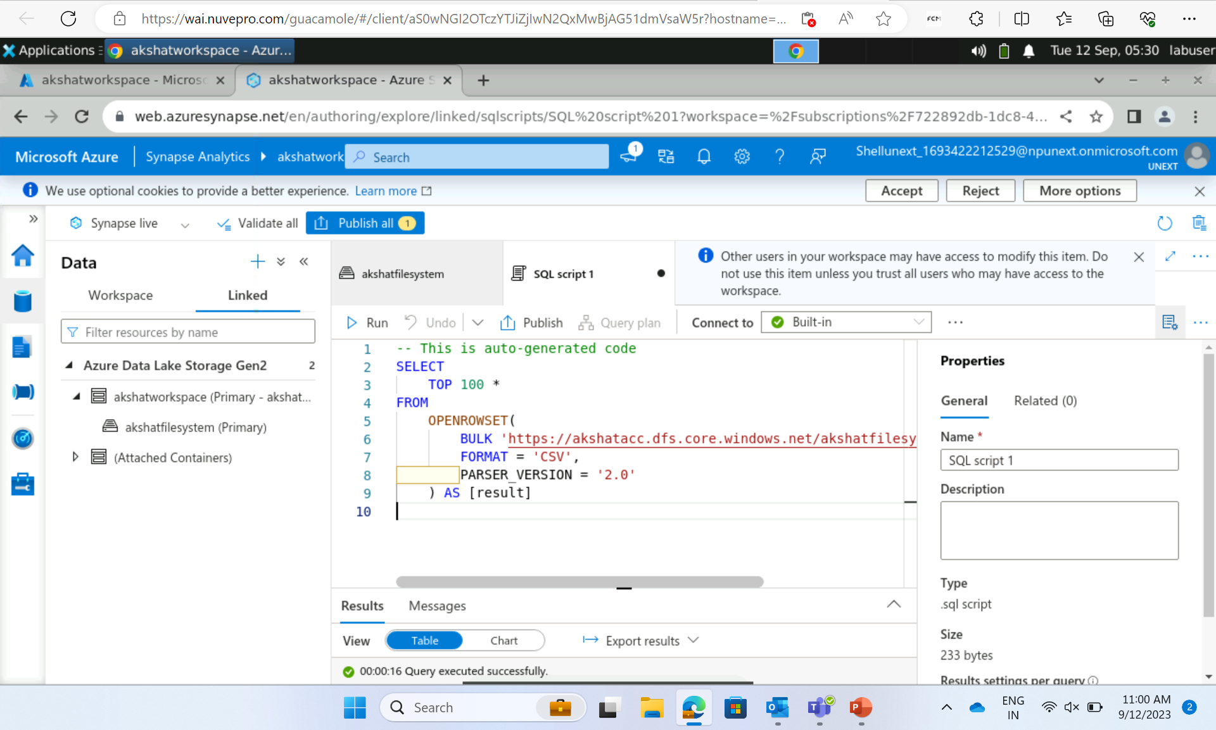

Slide 6
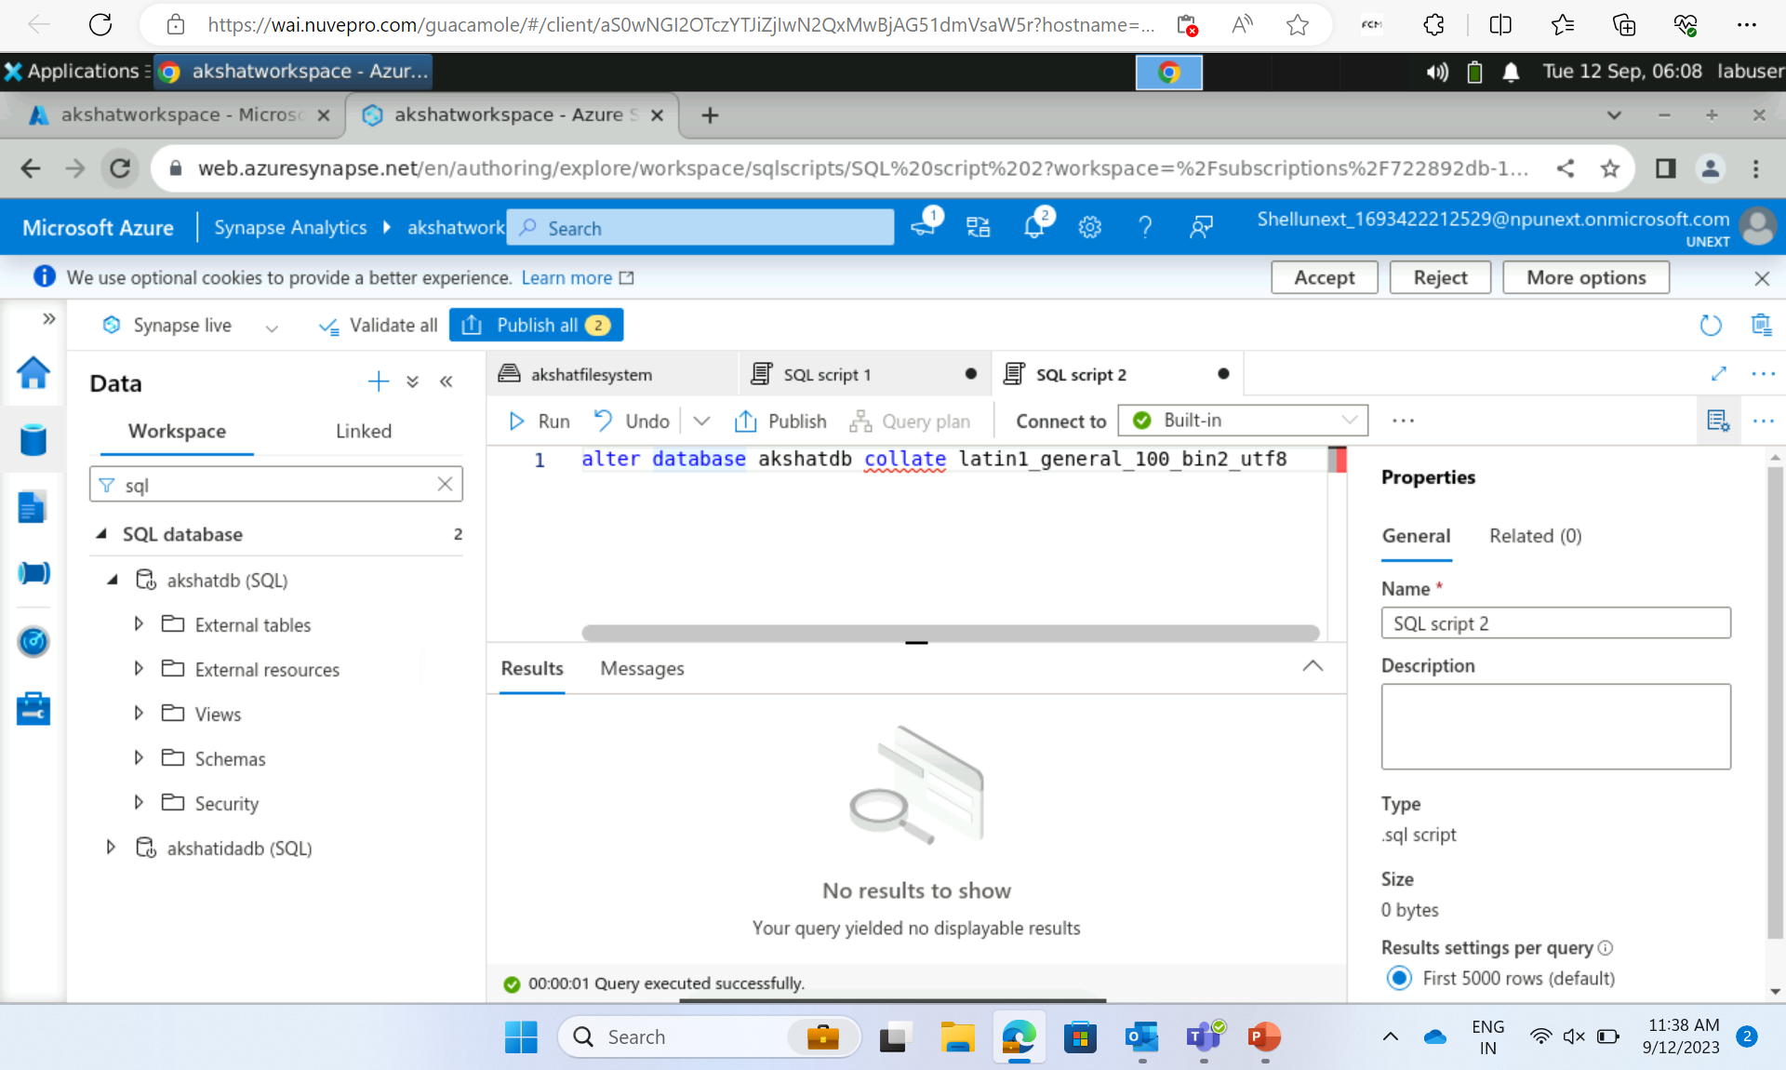
Creating serverless SQL pool with database ‘ akshatdb’

Slide 7
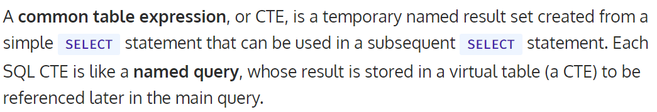
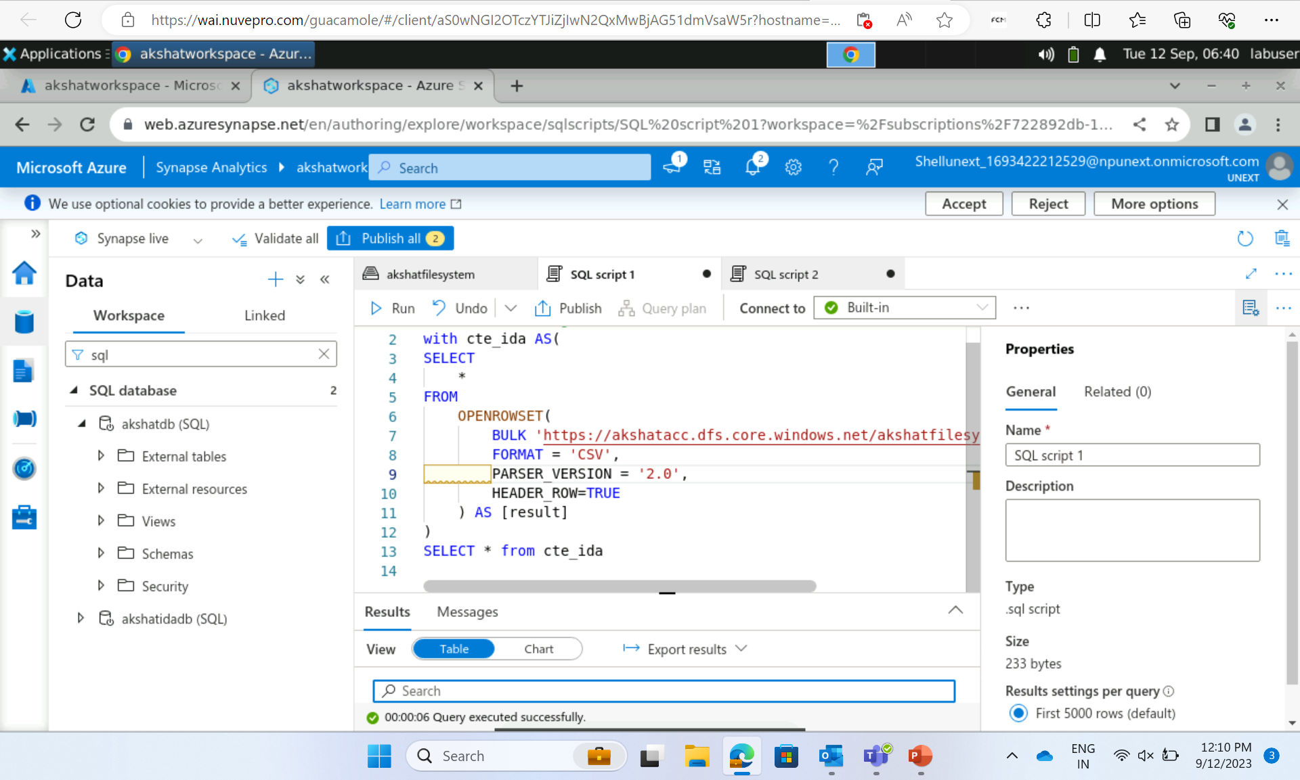
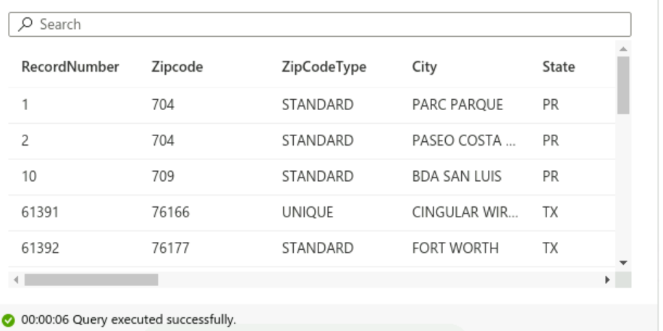
CTE -
OUTPUT

Slide 8
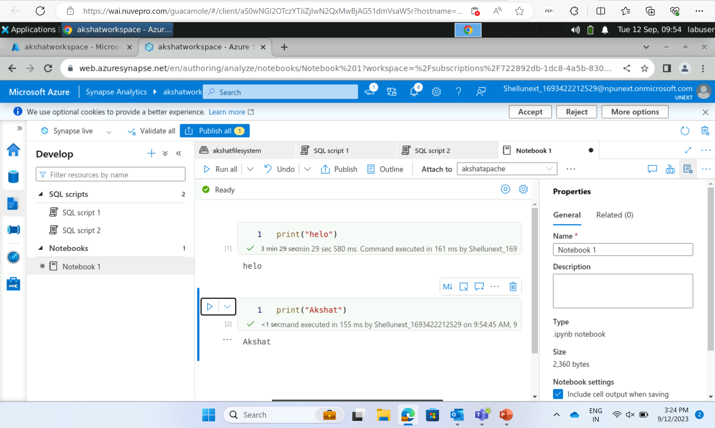
Apache Spark Pool

Slide 9
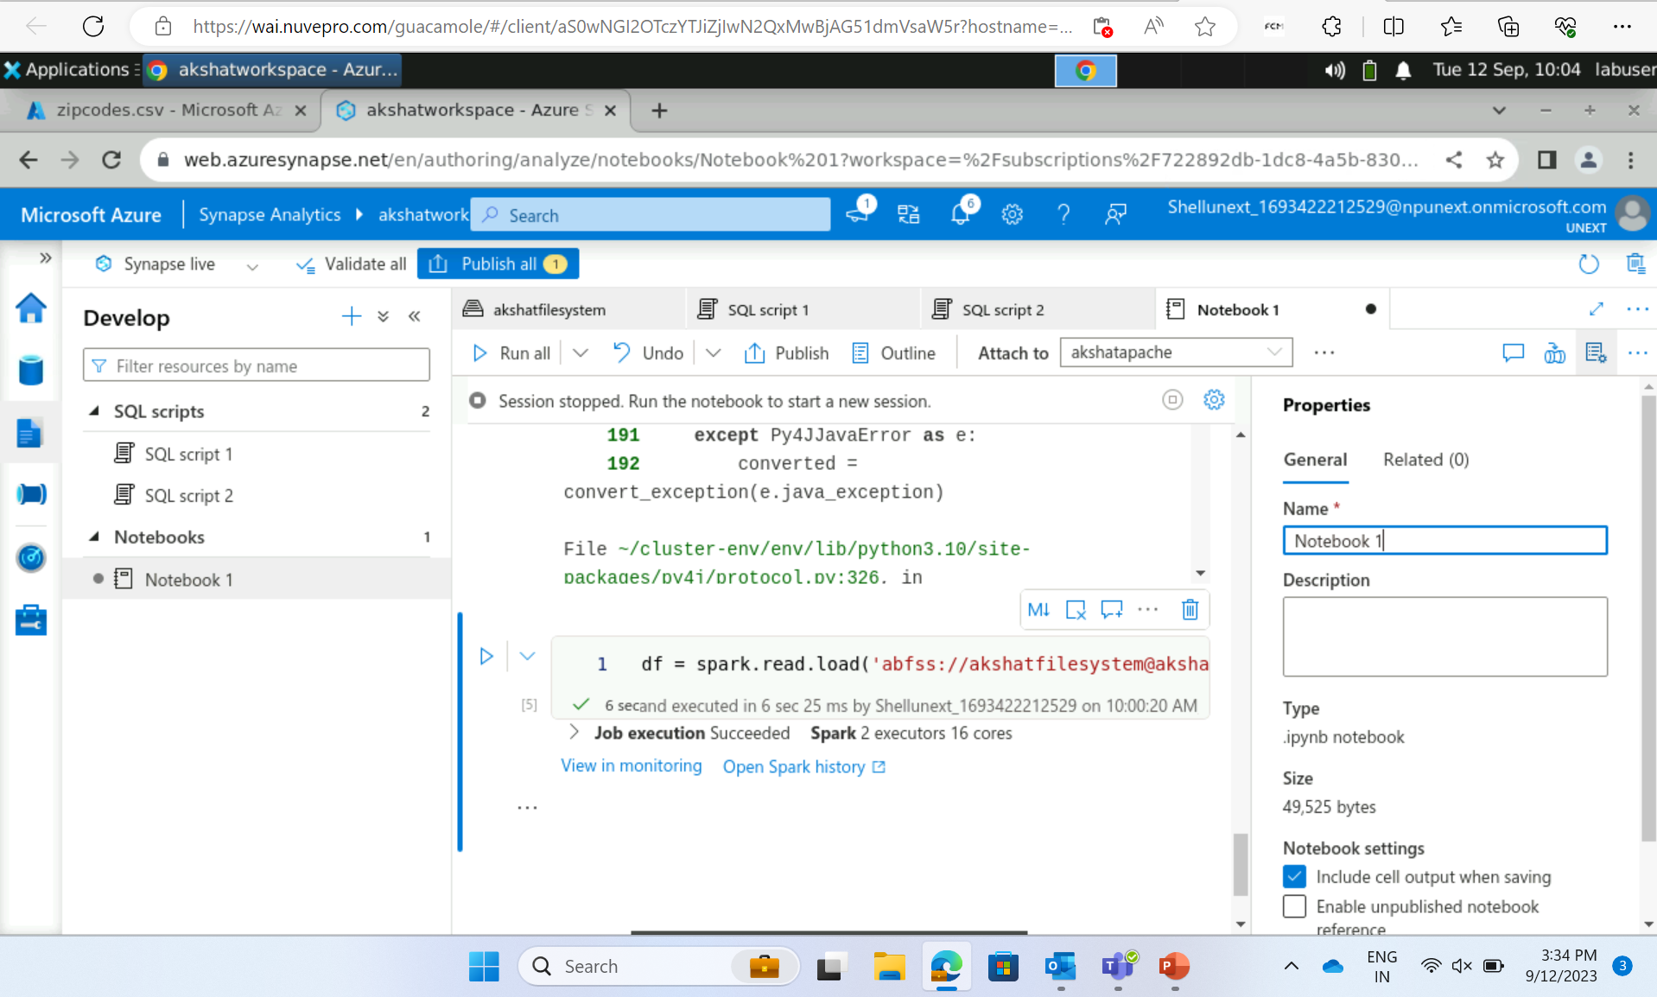

Slide 10
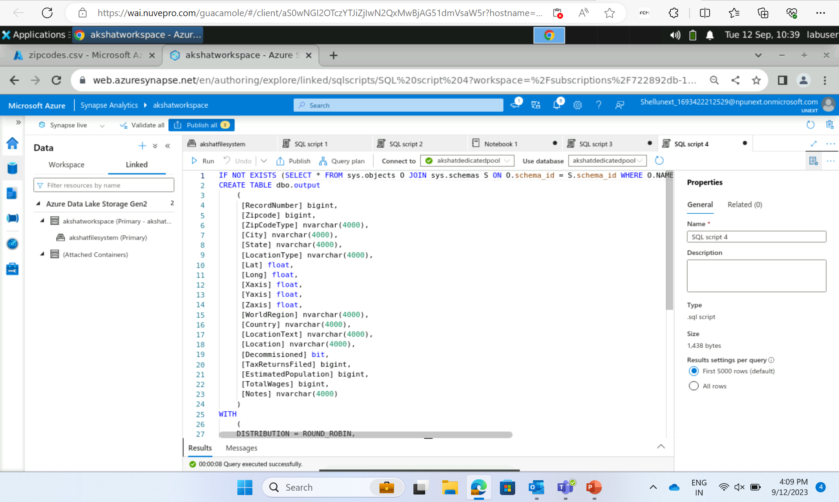
Dedicated pool – bulk load

Slide 11
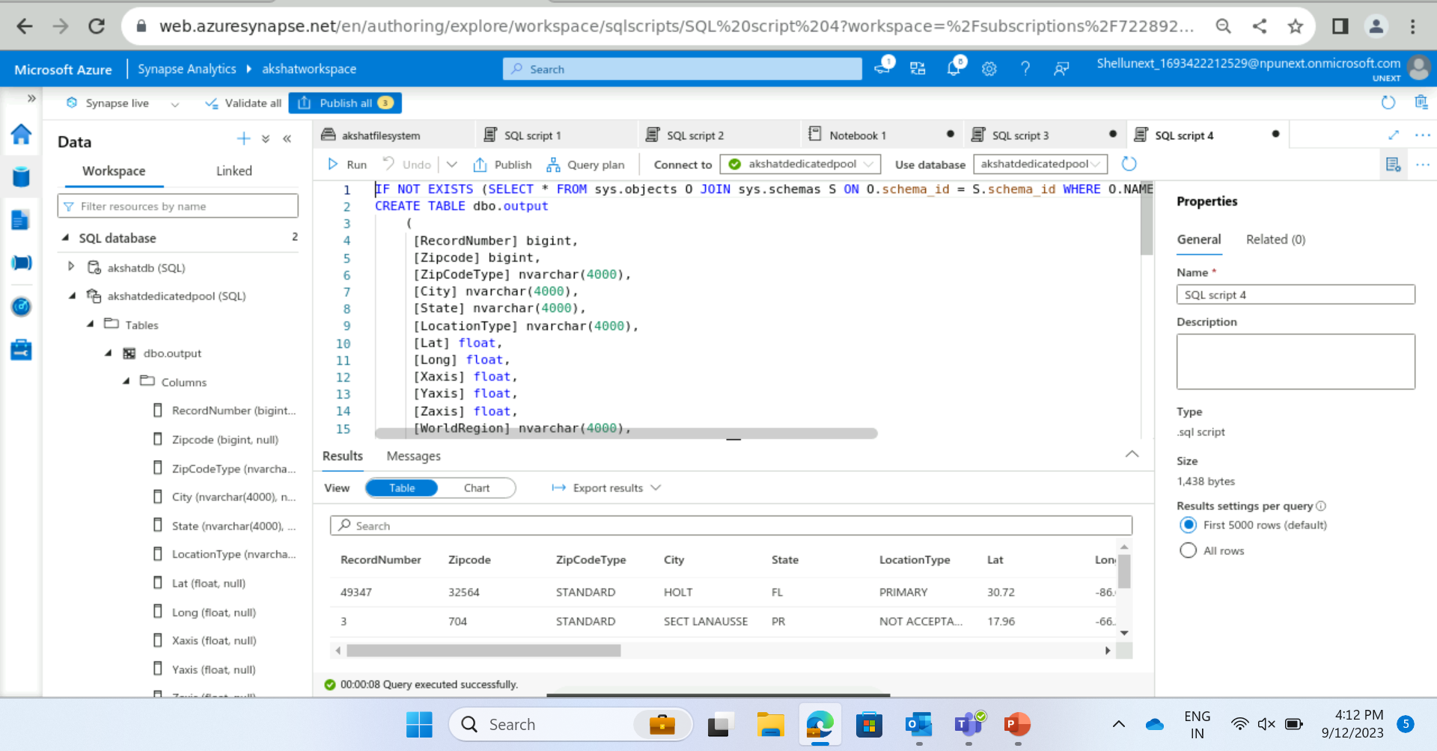
Dedicated pool – bulk load

Slide 12
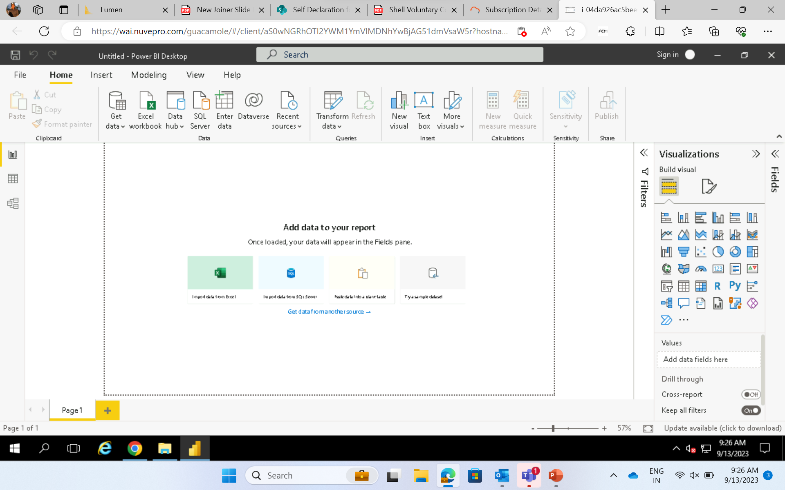
Day 3
Power BI – Data Visualization tool

Slide 13
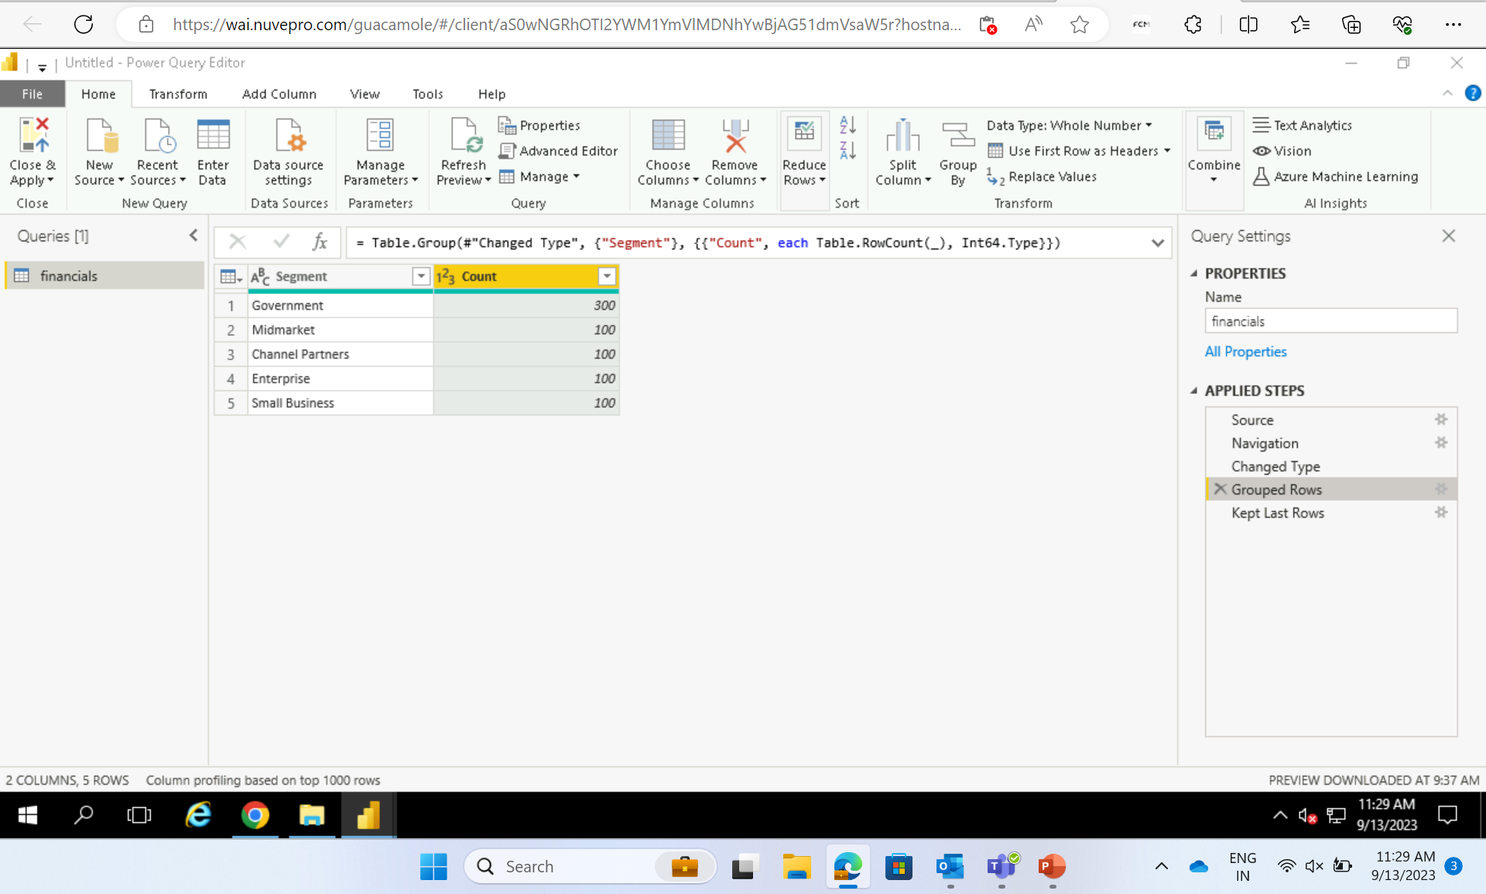
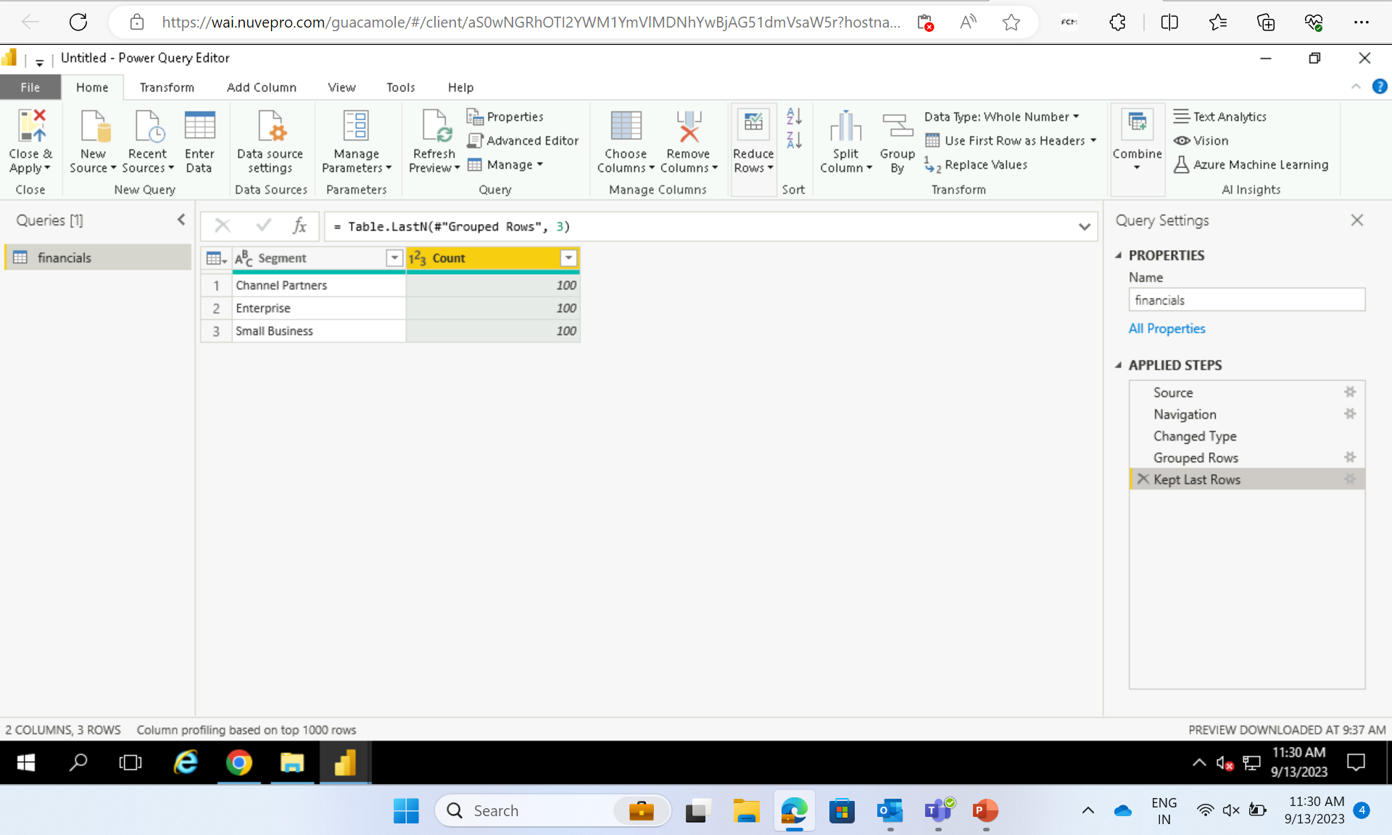
Transformation – Group By
Keep last row

Slide 14
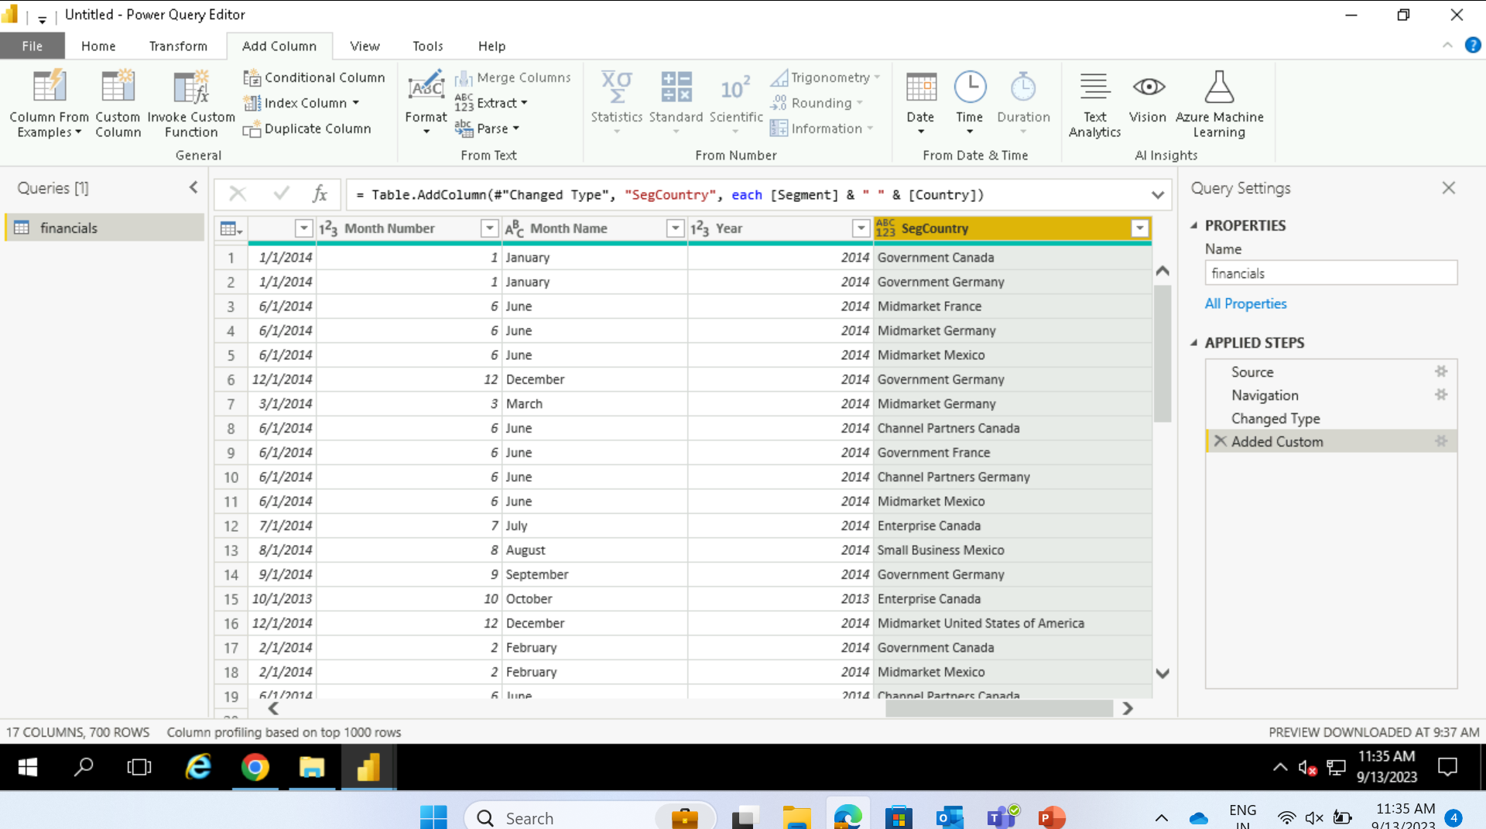
Custom column creation

Slide 15
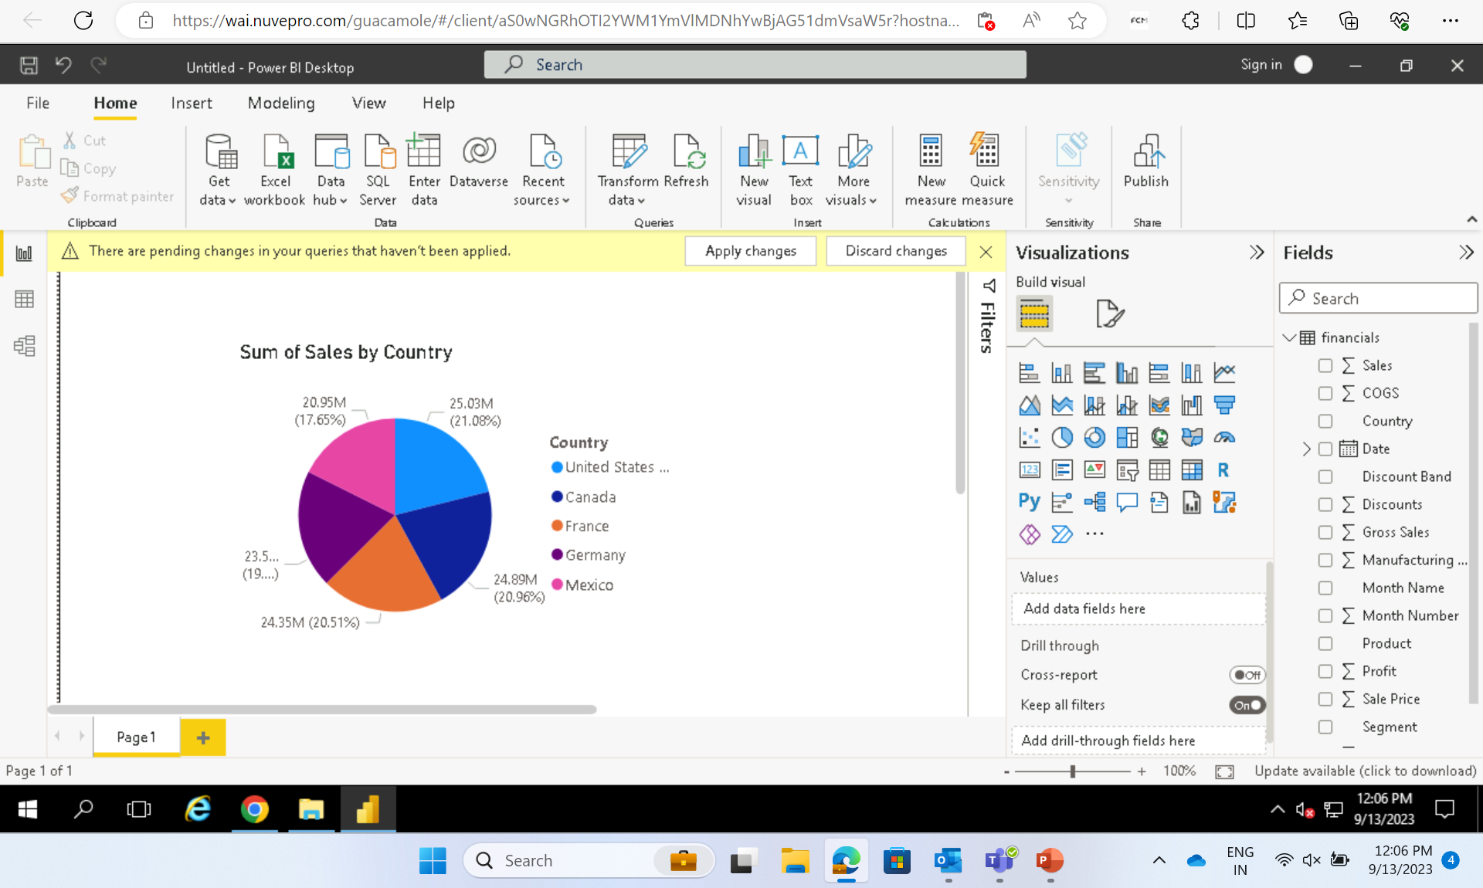

Slide 16
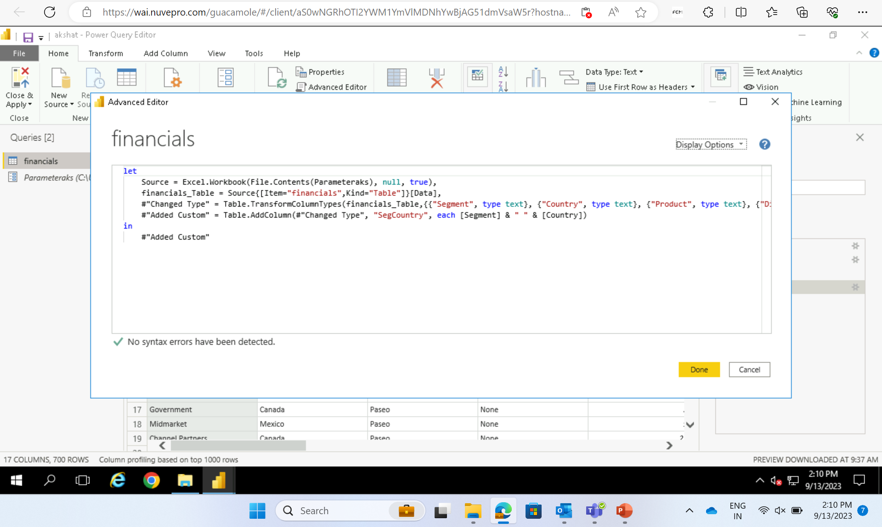
Adding parameter

Slide 17
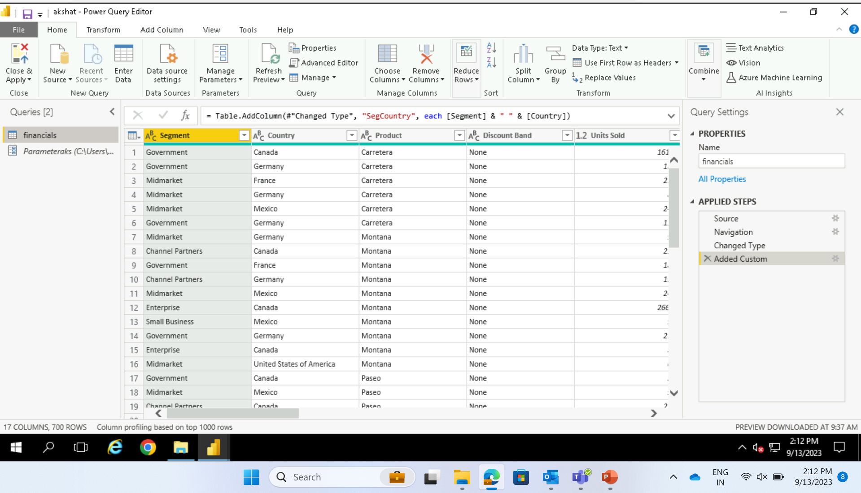
Parameterization

Slide 18
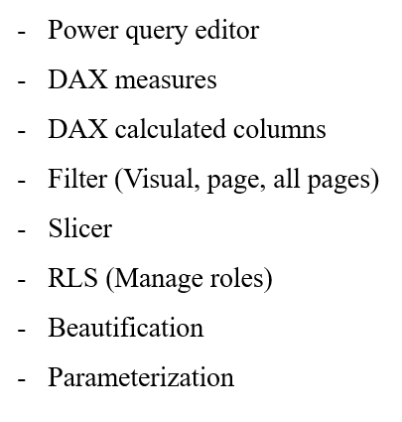

Slide 19
Day 4 – Power BI
Connect data source to an on-premise SQL server
Univariant
Bivariant
Multivariant
Drill through concept

Slide 20
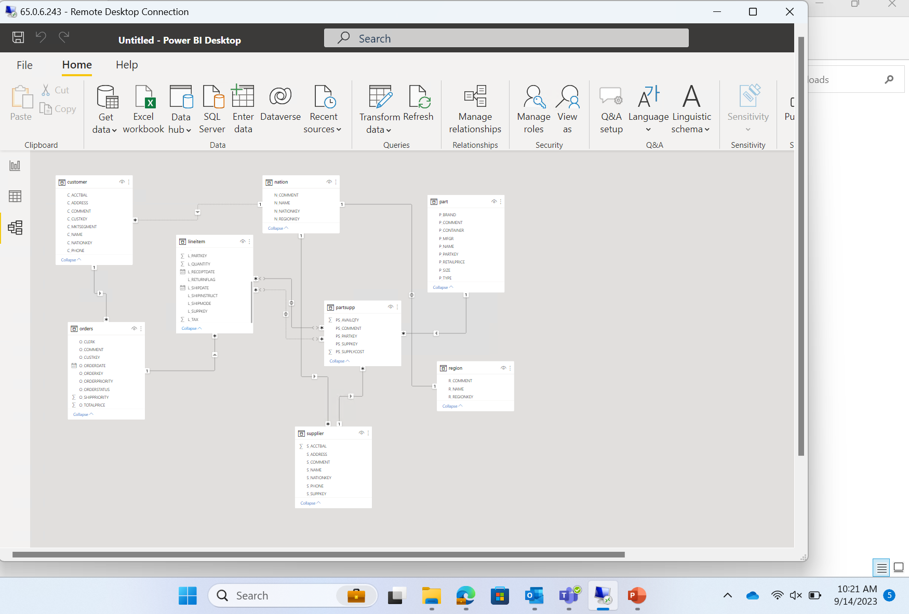
Managing relationships – ER diagram

Slide 21
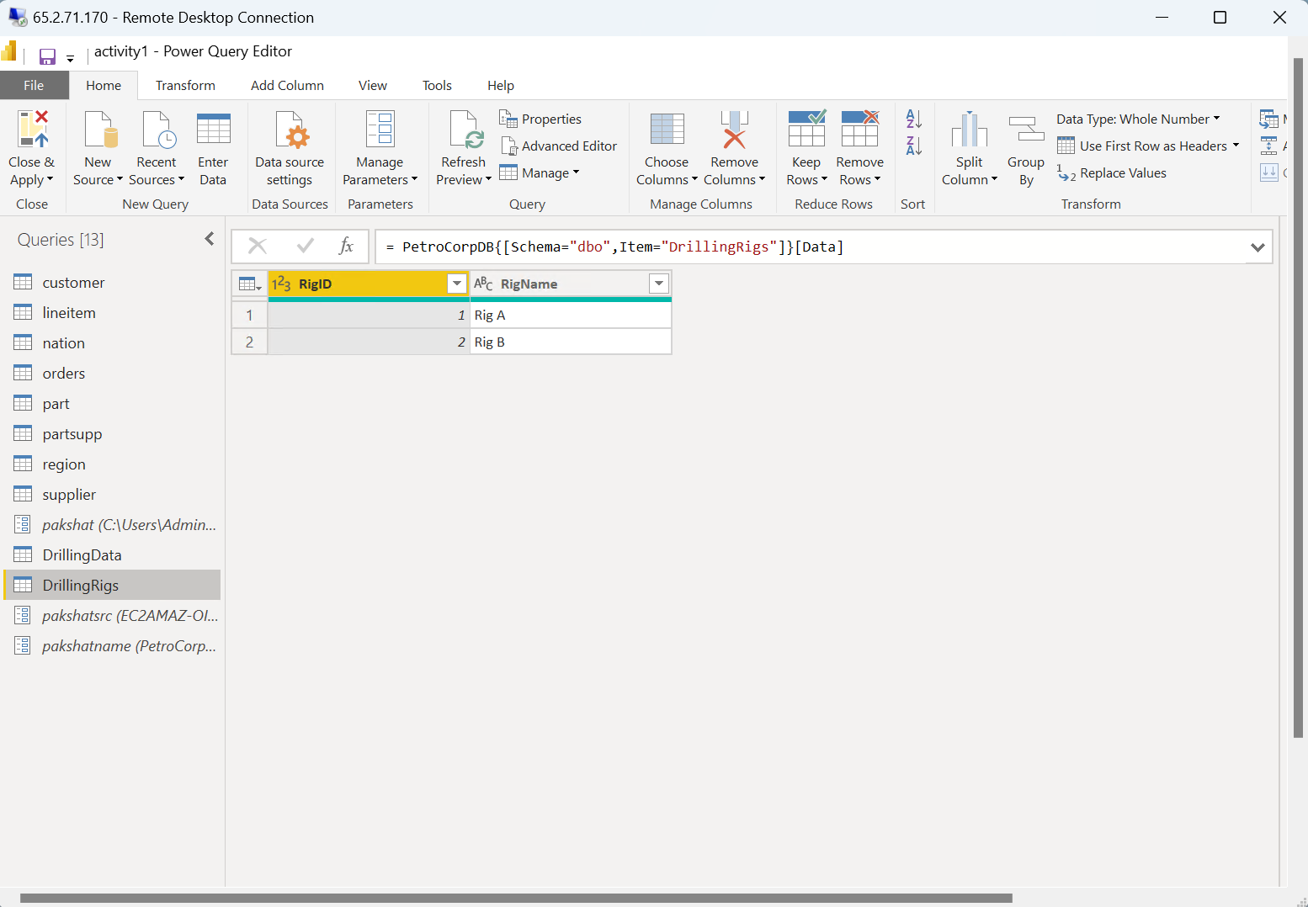
Using SQL Server

Slide 22
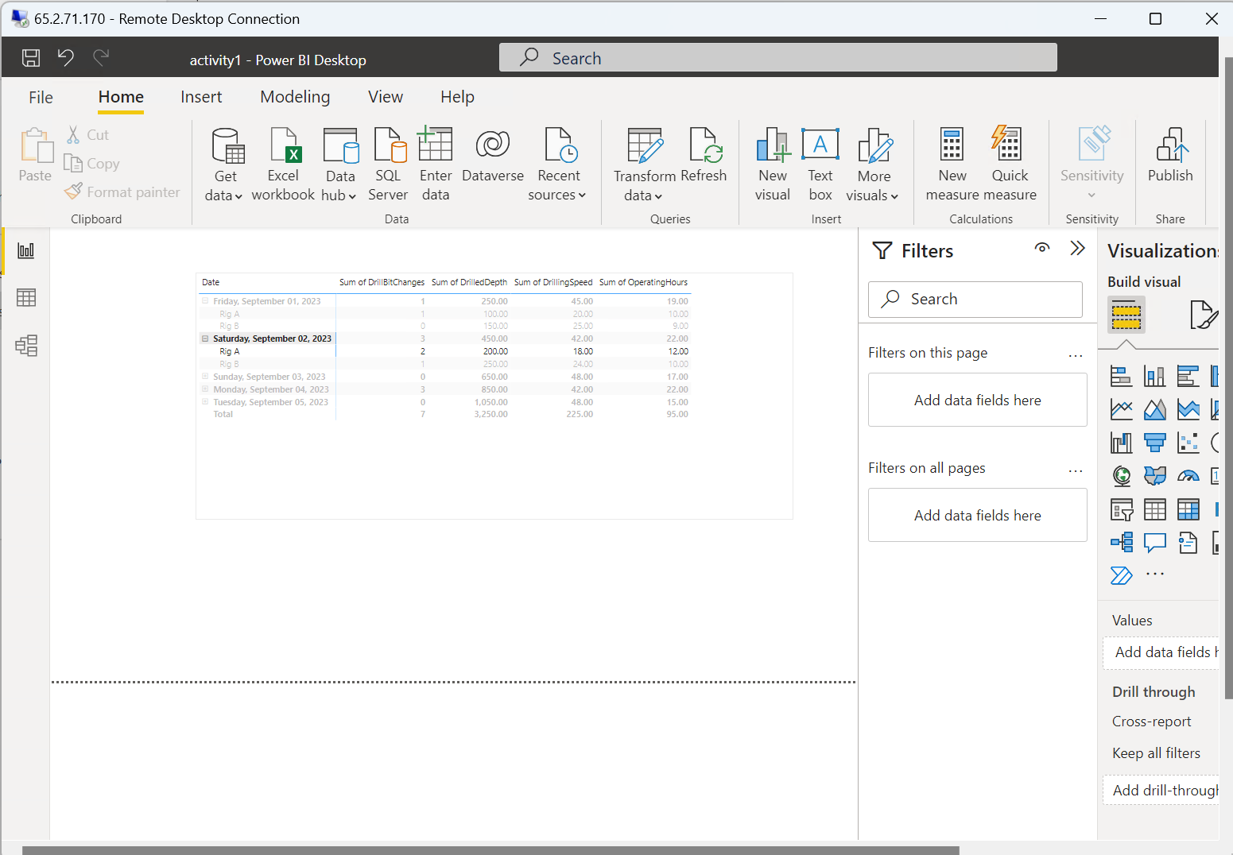
Using matrix

Slide 23
Day 5
Hands on assessment on Power Bi
Jupyter Notebook Launch
Started learning Python
Data Types : Integer, Float, String, List, Tuple, Dictionary, Boolean
Arithmetic
Logic

Slide 24
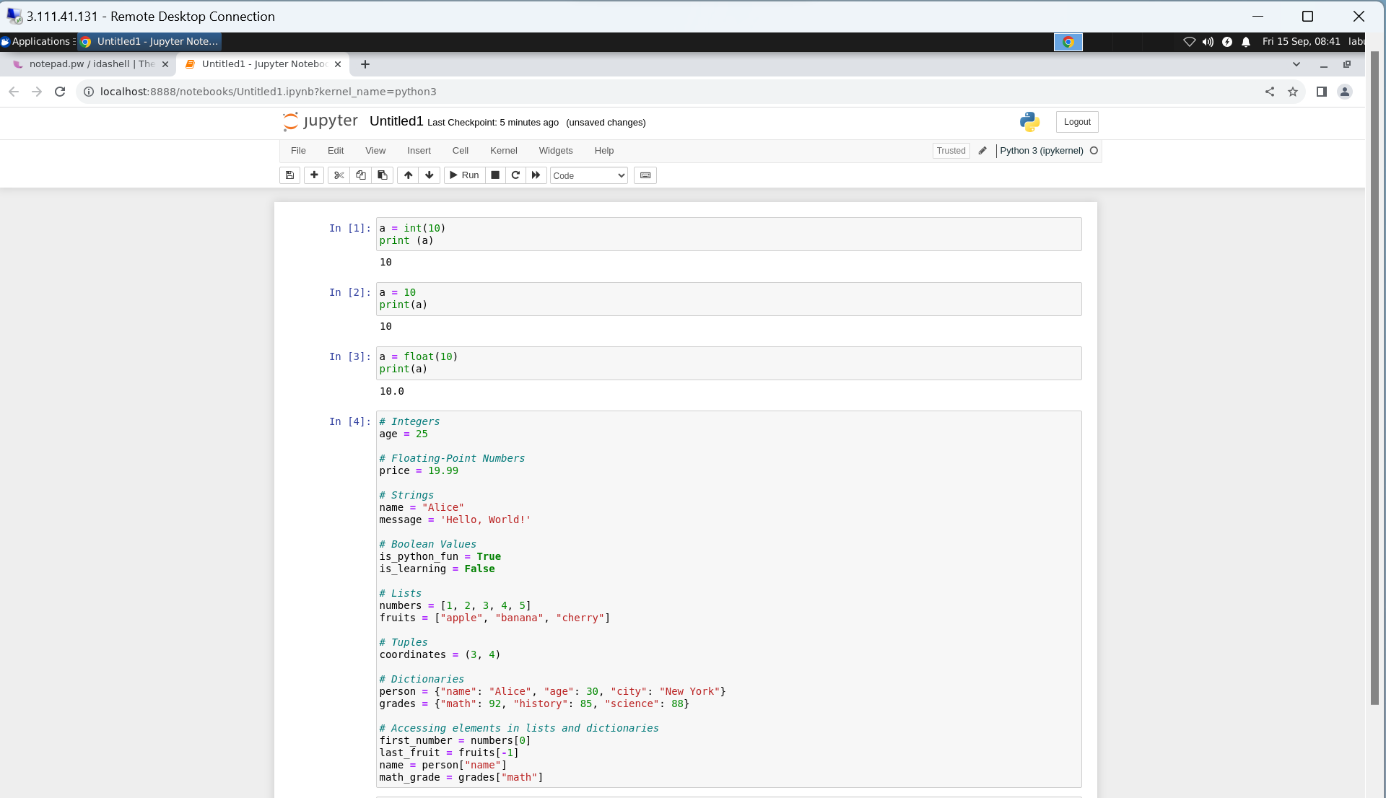

Slide 25
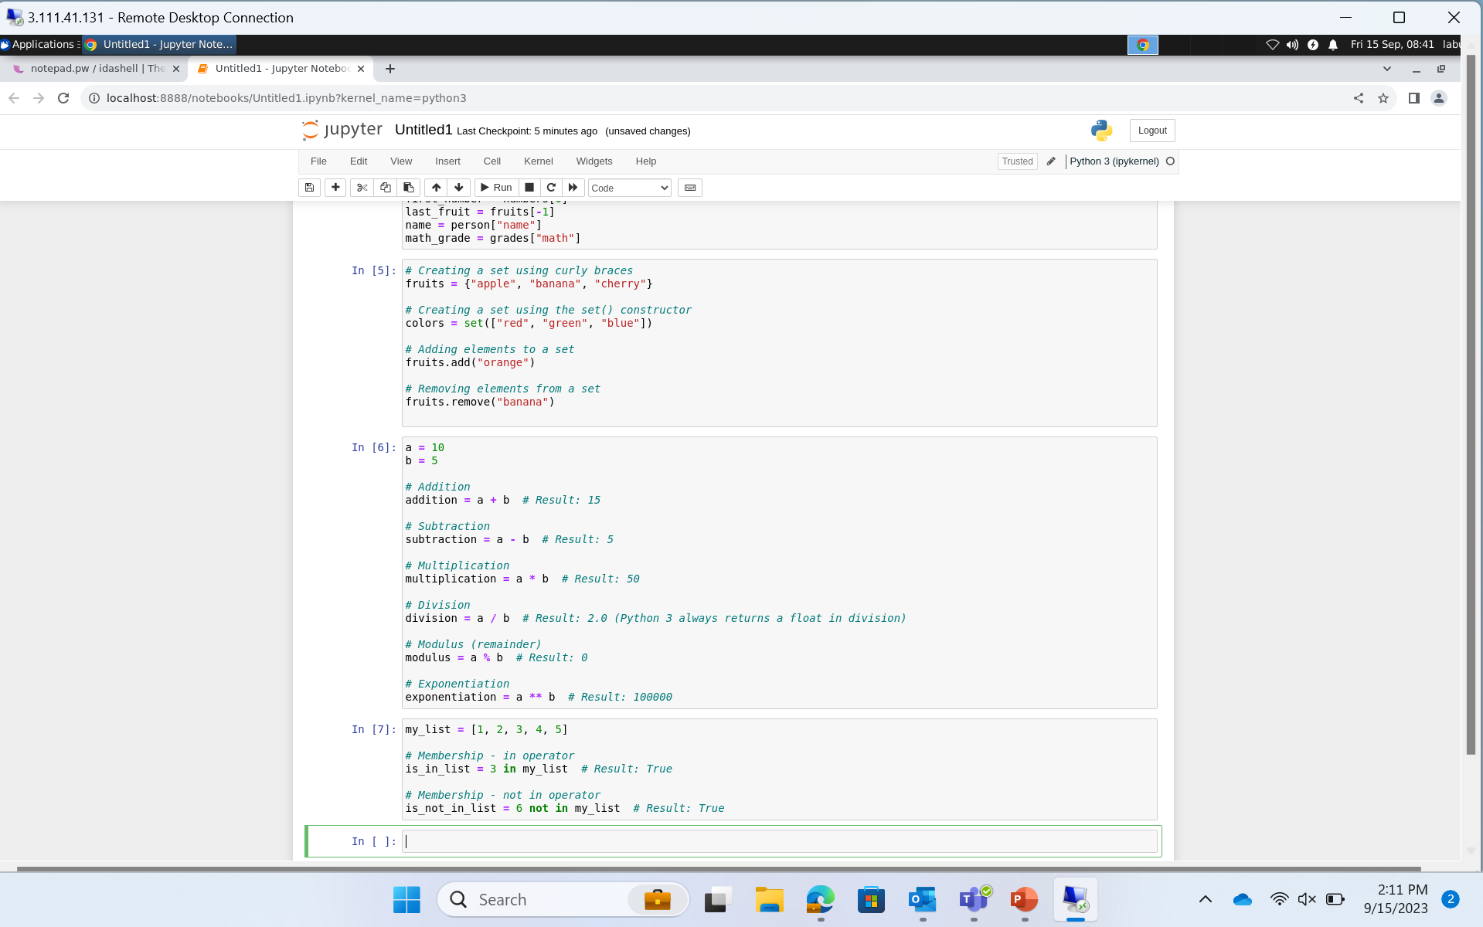

Slide 26
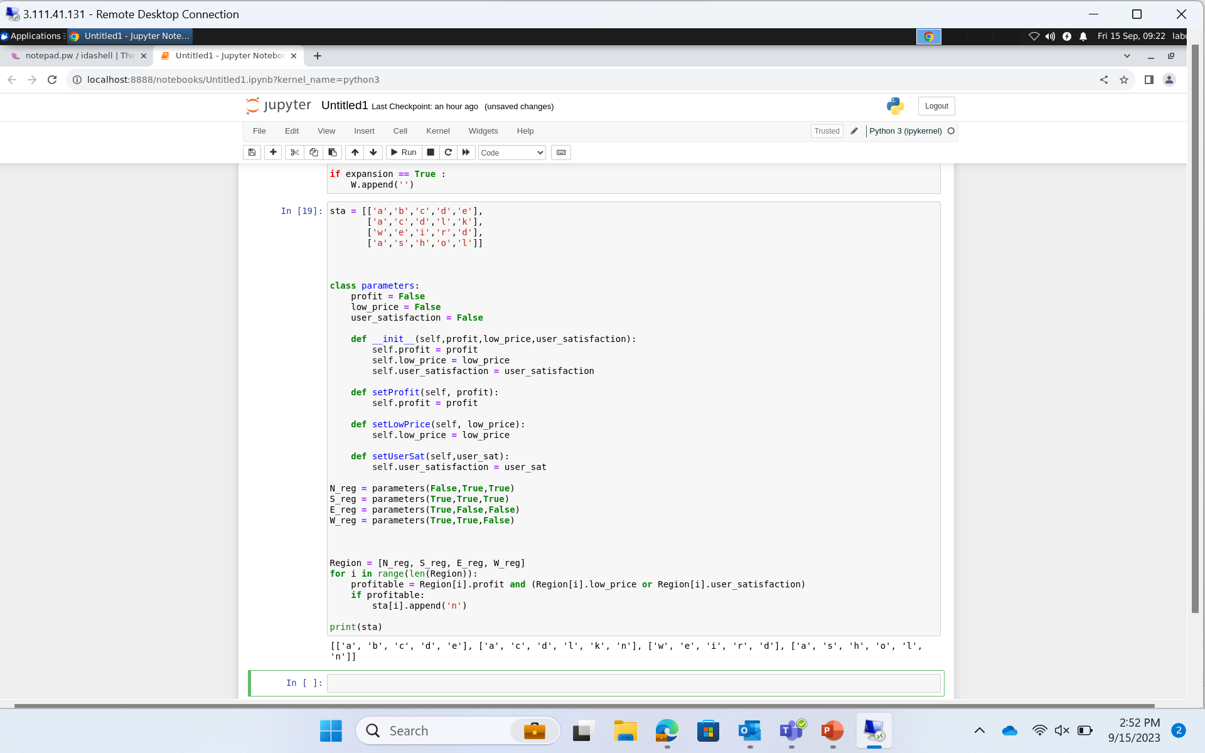

Slide 27
Thank you
Akshat Gupta
Akshat.gupta2@shell.com

